Slide 1


QuAS: Quantum Application Score
TQCI quantum computer benchmarking
Koen Mesman, Ward van der Schoot
Matthias Möller, Niels Neumann

Slide 2

Study on application-level benchmarking
What computer benchmarking should be
What classical benchmarking currently is
What quantum benchmarking currently is
Quantum Application Score

Slide 3
What computer benchmarking should be
Application-level benchmarking
Measuring performance of computers on real-world problems
What is performance?
What type of performance matters?
How do you quantify it?
What is a real-world problem?
Which problems matter?
Which resources do you use?

Slide 4

What is performance?
INPUT
OUTPUT
Problem description
Problem instances
Output value
Time to solution
Resources
Parameters
Energy taken
Solution from output
Allowed operations
…
Errors
…

Slide 5
What is performance?
INPUT
OUTPUT
Problem description
Problem instances
Output value
Resources
…

Slide 6
What is performance?
INPUT
OUTPUT
Problem description
Output value
Time to solution
Parameters
Solution from output
Allowed operations
…

Slide 7
What are real-life problems?
Communication & Connectivity
AI and Machine Learning
Data processing & Analysis
Computation
Simulation
Optimisation
…
Randomisation

Slide 8
What computer benchmarking should be
Take-aways
Computers are used for a vast amount of tasks
Each task requires solving vastly different problems
Each use case has different requirements on performance
This should form the blueprint for benchmarking

Slide 9
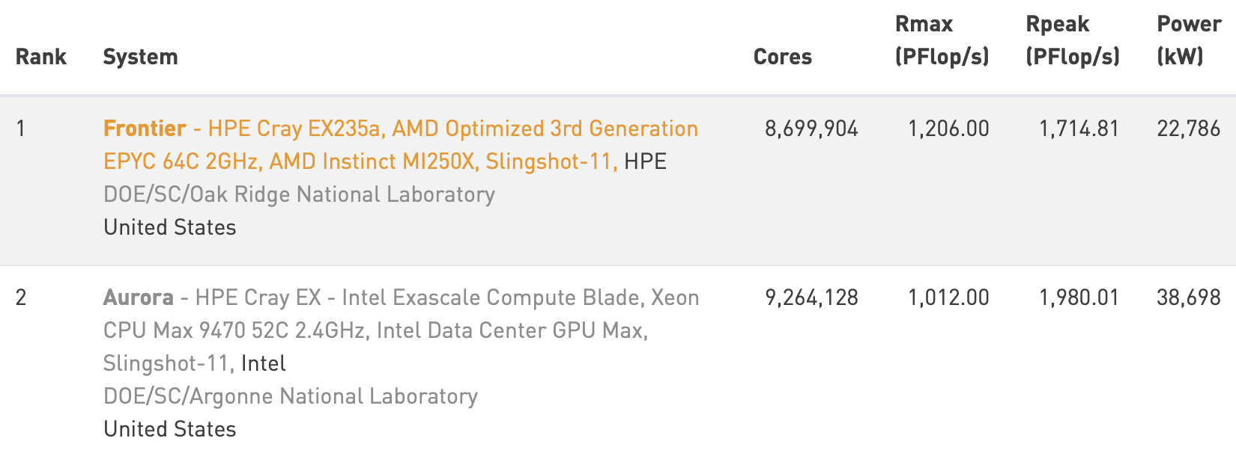
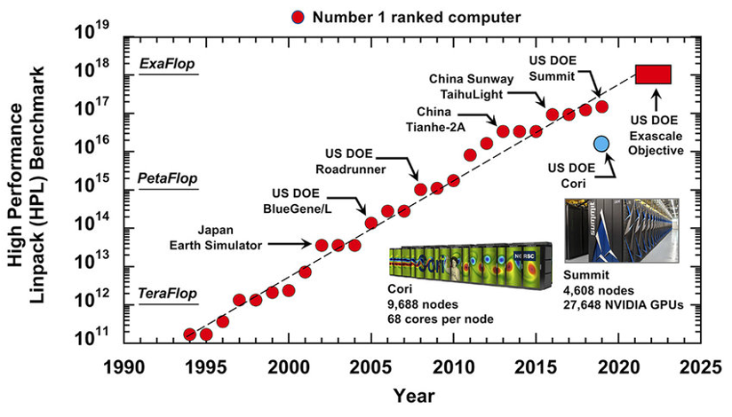
What classical benchmarking currently is
Theme name
Place text here
Solving dense system of linear equations
Single-score
Using specified solution method
Scalable
Linpack benchmark
Advantages
Critique
Lessons for quantum
Solving linear systems is not representative
Single application & method not representative
HPC systems optimise system w.r.t. benchmark
Benchmark must stimulate full optimisation
Single score allows comparing ; hides relevance

Slide 10
What quantum benchmarking currently is
Theme name
Place text here
Quantum Linpack
Open QBench
Q-score
QED-C metrics
Single-score
Suites
Frameworks
Common denominator
Q-score/ BACQ
QPack
Performance measured in predefined way
SupermarQ
QUARK

Slide 11
Quantum Application Score - idea
“Best tool for the job” indicator
Any problem/
use case
Hardware agnostic
User-tailored scoring metric
Any quantum paradigm
QuAS
Single but subdivisible score
Any combination of KPIs with any weights
Clear representation of KPI trade-offs
Scalable beyond NISQ

Slide 12
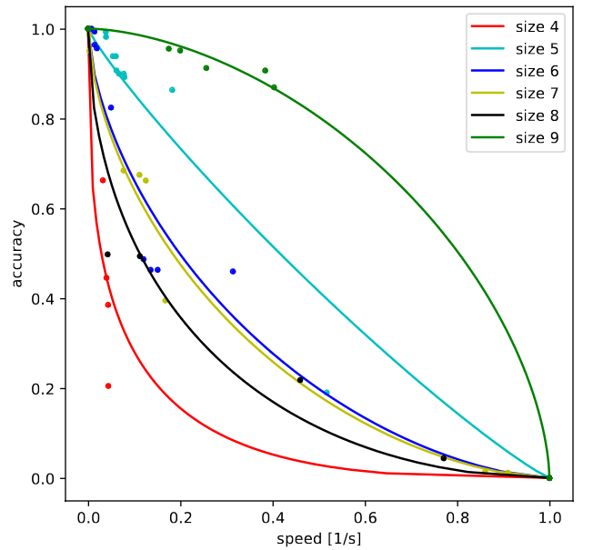
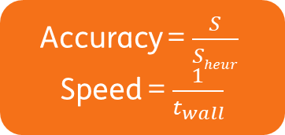
Quantum Application Score - workings
Given a chosen problem and data points run on that problem
1. Compute score in [0,1] per KPI
2. Plot each data point in XD space with X KPIs
3. Each axis scaled with weight of KPI
4. Fit a curve to data points
5. Compute area/volume of obtained surface
Accuracy = $\frac{S}{Sheur}$
Speed = $\frac{1}{t_{wall}}$
Plot data points in 2D-space
Give both weight = 1 (equal importance)
How to compute each KPI as a value in [0,1]?
Difficulties
How to fit curve to data points?

Slide 13
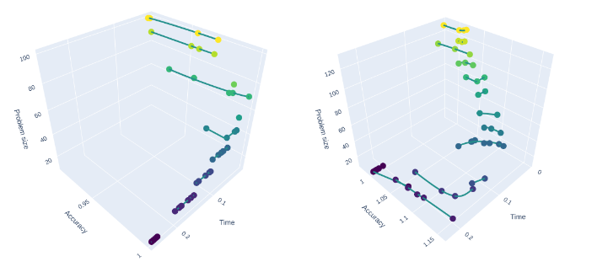
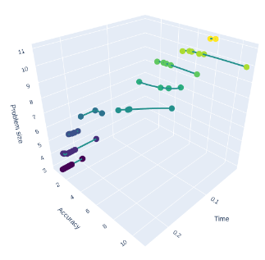


Quantum Application Score - results
Tested for Ising Problem, Max-Cut Problem and Travelling Salesman Problem
Tested on D-Wave, IBM, Quantum Inspire and Rigetti
Accuracy = $\frac{S}{Sheur}$
Speed = $\frac{1}{t_{wall}}$
Size = $\frac{qubits}{1000}$
All 3 KPIs with equal weight
$L_{p}$-curves fitted with Pareto fronts
Ising
Max-Cut
TSP

Slide 14
Conclusion

Slide 15
Conclusion
Application-level benchmarking
Measuring performance of computers on real-world problems

Slide 16
Conclusion
Application-level benchmarking
Measuring performance of computers on real-world problems

Slide 17
Conclusion
Application-level benchmarking
Measuring performance of computers on real-world problems
Blueprint
Computers are used for a vast amount of tasks
Each task requires solving vastly different problems
Each use case has different requirements on performance

Slide 18
Conclusion
Application-level benchmarking
Measuring performance of computers on real-world problems
Blueprint
Computers are used for a vast amount of tasks
Each task requires solving vastly different problems
Each use case has different requirements on performance

Slide 19
Conclusion
Application-level benchmarking
Measuring performance of computers on real-world problems
Blueprint
Computers are used for a vast amount of tasks
Each task requires solving vastly different problems
Each use case has different requirements on performance
Single but subdivisible score
Any problem/ use case
Not about the specific metric!
User-tailored scoring metric
Any quantum paradigm
QuAS
Clear representation of KPI trade-offs
Any KPIs with any weight

Slide 20




Thank you Questions? ward.vanderschoot@tno.nl

