Slide 1
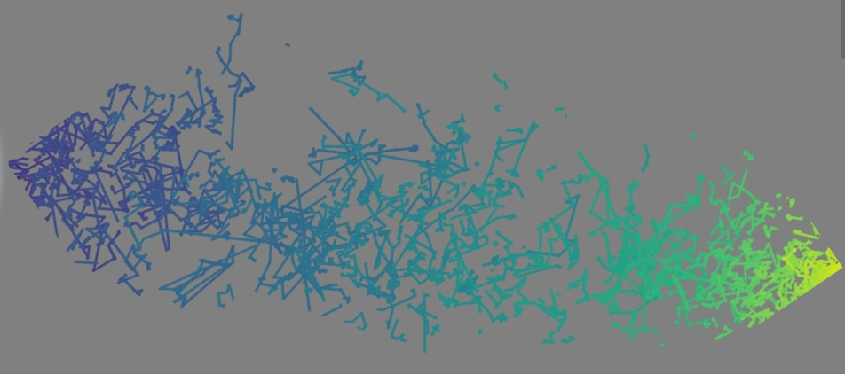
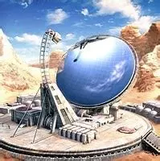
Sampling rare events on Quantum Computers
analog trajectories
source
reactive
trajectories
Thales Research & Technology Quantum Computing team
detector
Goal: maximize number of counts in the detector

Slide 2
Monte Carlo on Quantum Computers: overview and motivation
Montanaro algorithm
Quantum speedup of Monte Carlo methods,
A. Montanaro, 2015
Amplitude amplitication on a real quantum computer
Low-depth amplitude estimation on a trapped-ion quantum computer
T. Giurgica-Tiron et al., 2022
Benchmarking Amplitude Estimation on a Superconducting Quantum Computer,
S. Certo et al, 2022
Quantum random walk
Quantum random walks - an introductory overview,
J. Kempe, 2003

Slide 3
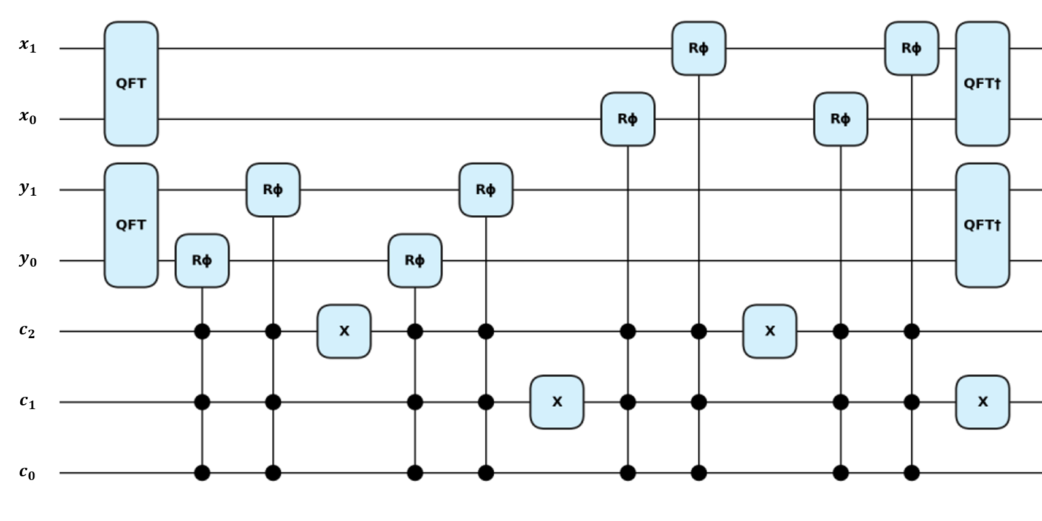
Particle transport on a grid-graph (1/2)
Monte Carlo particle transport on quantum computers,
Noé Olivier and Michel Nowak, 2024
Step 1: Discretize the geometry
Step 2: define shift operator
POSITIONS
COIN
Gate-Based Circuit Designs For Quantum Adder Inspired Quantum Random Walks on Superconducting Qubits, D. Koch et al., 2021
7 qubits
9 qubits
13 qubits

Slide 4
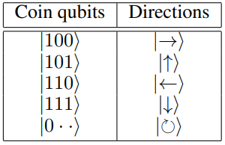
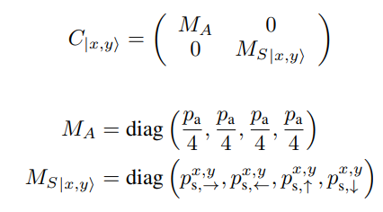
Particle transport on a grid-graph (2/2)
Monte Carlo particle transport on quantum computers,
Noé Olivier and Michel Nowak, 2024
Step 3: particle transport coin operator
Geometry/cross section aware coin operator
POSITIONS
COIN
ancilla
Quantum circuits for discrete-time quantum walks
with position-dependent coin operator
Ugo Nzongani et al, 2023
-
+
Boundary conditions
set local scattering probability to 0
Reset coin at each step
Efficient Quantum Circuits for Non-Unitary and Unitary Diagonal Operators with Space-Time-Accuracy trade-offs
J. Zylberman et al., 2024

Slide 5
Circuits for particle transport
Monte Carlo particle transport on quantum computers,
Noé Olivier and Michel Nowak, 2024
Circuit with positions only
FINAL POSITIONS
POSITIONS
COIN
ancilla
ancilla
Circuit with score
coin preparation
transport 1 iteration
Swap test
POSITIONS
COIN
ancilla
ancilla
RESPONSE
score preparation
FINAL SCORE

Slide 6
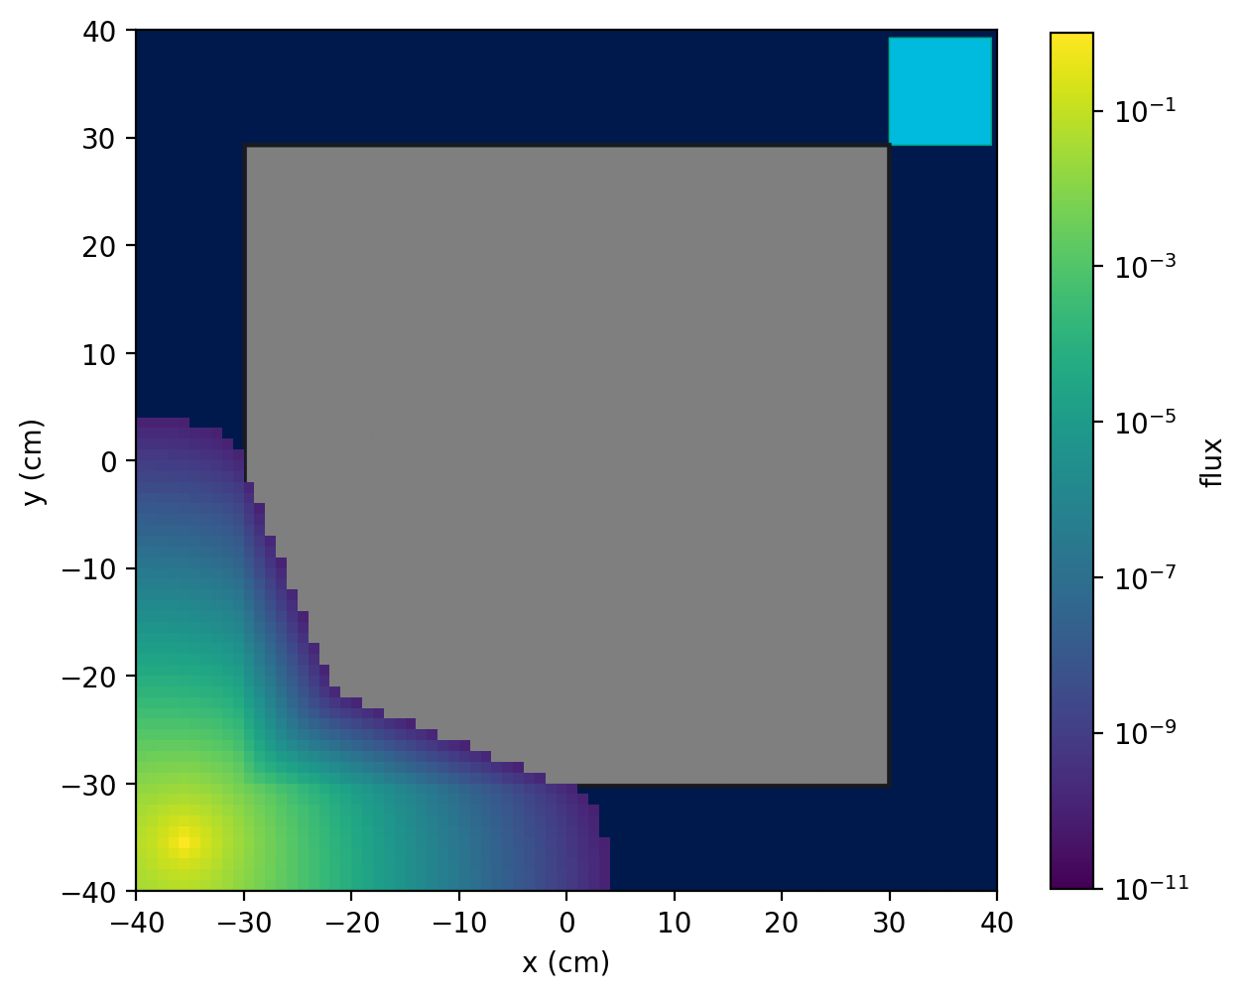
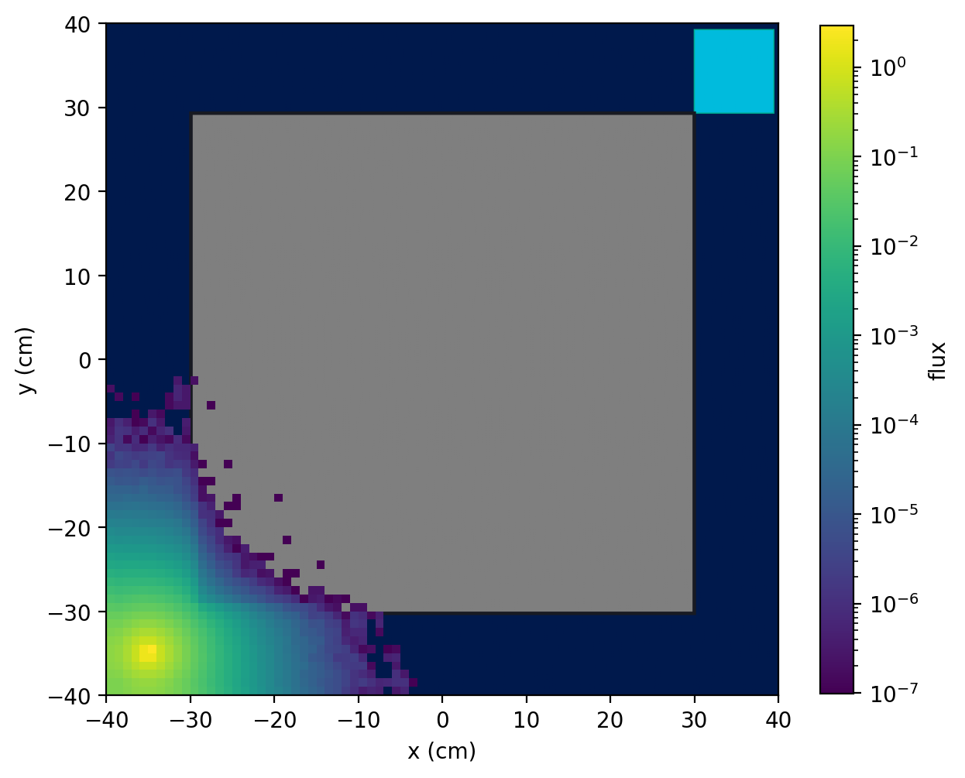
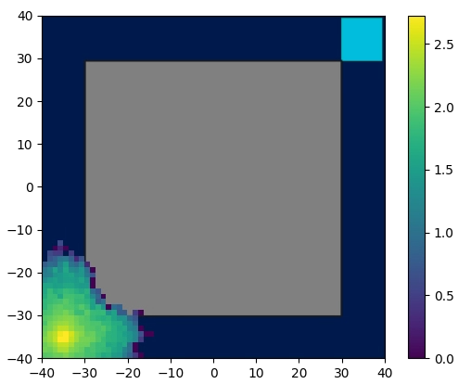
Flux comparison
Monte Carlo particle transport on quantum computers,
Noé Olivier and Michel Nowak, 2024
classical finite differences
classical Monte Carlo
measured quantum

Slide 7
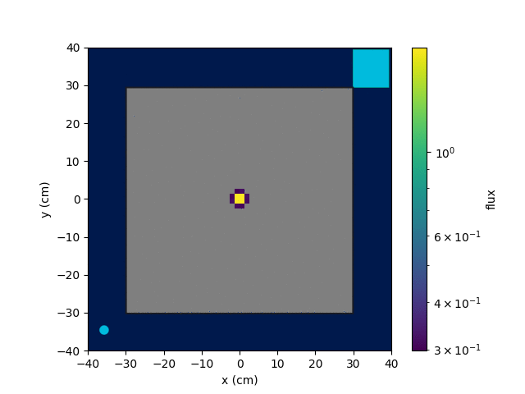
Quantum walk failure in the analog regime
Guarantee of convergence
Quantum walks can find a marked element on any graph,
Hari Krovi et al, 2010
OK, but not always in a reasonable amount of time
Especially when starting from a localized state
Especially when they are absorbing conditions

Slide 8
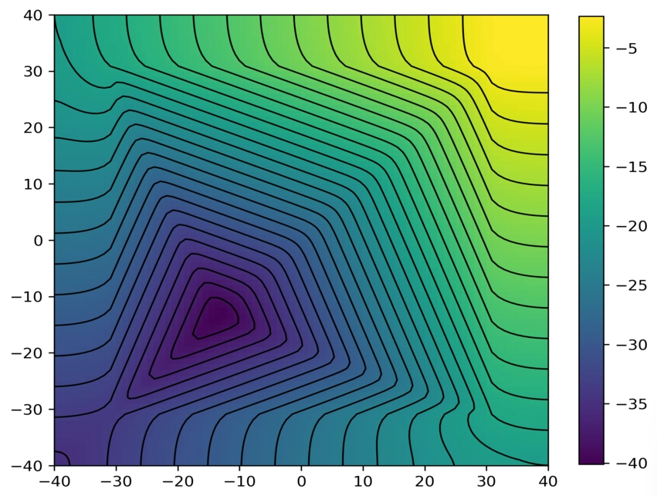
The need for an importance map
Scalar importance map
Computed with a finite difference solver
Gives the expected contribution for 1 particle starting from x to the detector response
Classical results with variance reduction
x10
same convergence rates
improved performance measure

Slide 9
Importance Sampling on quantum computers (1/2)
Exponential transform
Extension to quantum formalism
Renormalize sampled distribution by importance map
Restart quantum walk for one shift operator call
Collision biasing
Population control
Splitting
Roulette
Variance reduction techniques
CEA, 2018

Slide 10
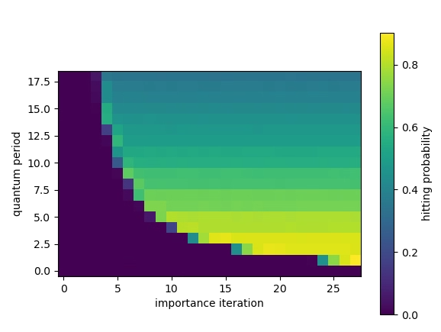
Importance Sampling on quantum computers (2/2)
Discussion
Tradoff between querying
The shift operator
the importance map
Constant hitting probability
With respect to importance map queries
Increasing hitting probability
By minimizing the number of quantum shift queries
Warning
Periodic boundary conditions applied
Reflective too expensive
better?
hitting threshold
0 counts

Slide 11
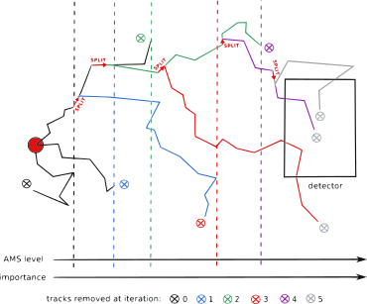
Adaptive Multilevel Splitting on quantum computers
Classical AMS
Restart K particles at each AMS iteration
Extension to a quantum formalism?
No need to follow weights
Because the weight is global for the restarted particles
Selection & Splitting needs to be classically implemented
Study tradoff between
Classical queries to the importance map
Quantum queries to the shift operator
Adaptive multilevel splitting for Monte Carlo particle transport, H. Louvin et al, 2017
Accelerating Monte Carlo particle transport with adaptively generated importance maps, M. Nowak, 2018

Slide 12
Amplitude estimation failure in the analog regime
Quantum amplitude amplification and estimation, Brassard et al, 2000
Iterative Quantum Amplitude Estimation
D. Grinko et al, 2021
Exponential integration with attenuation

Slide 13
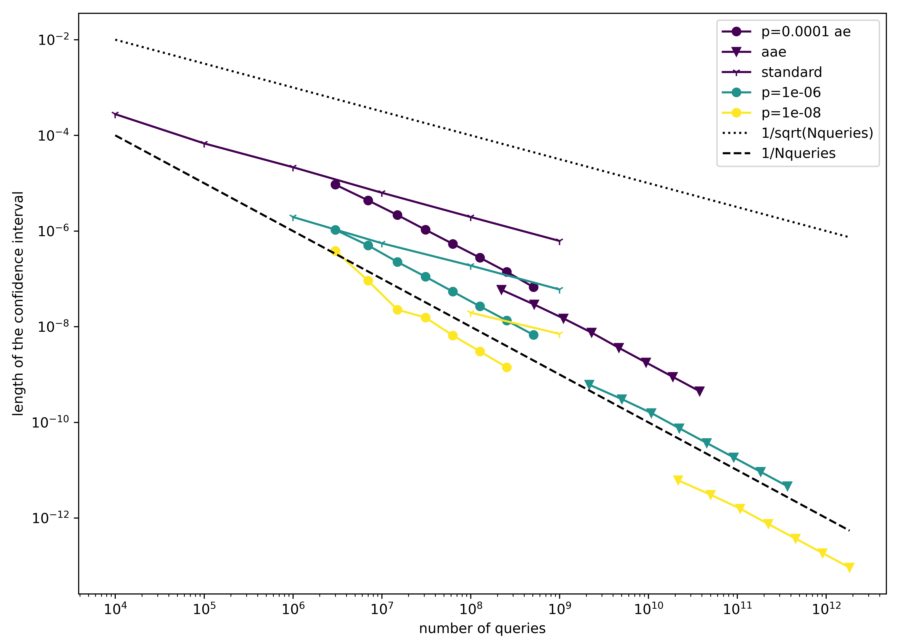
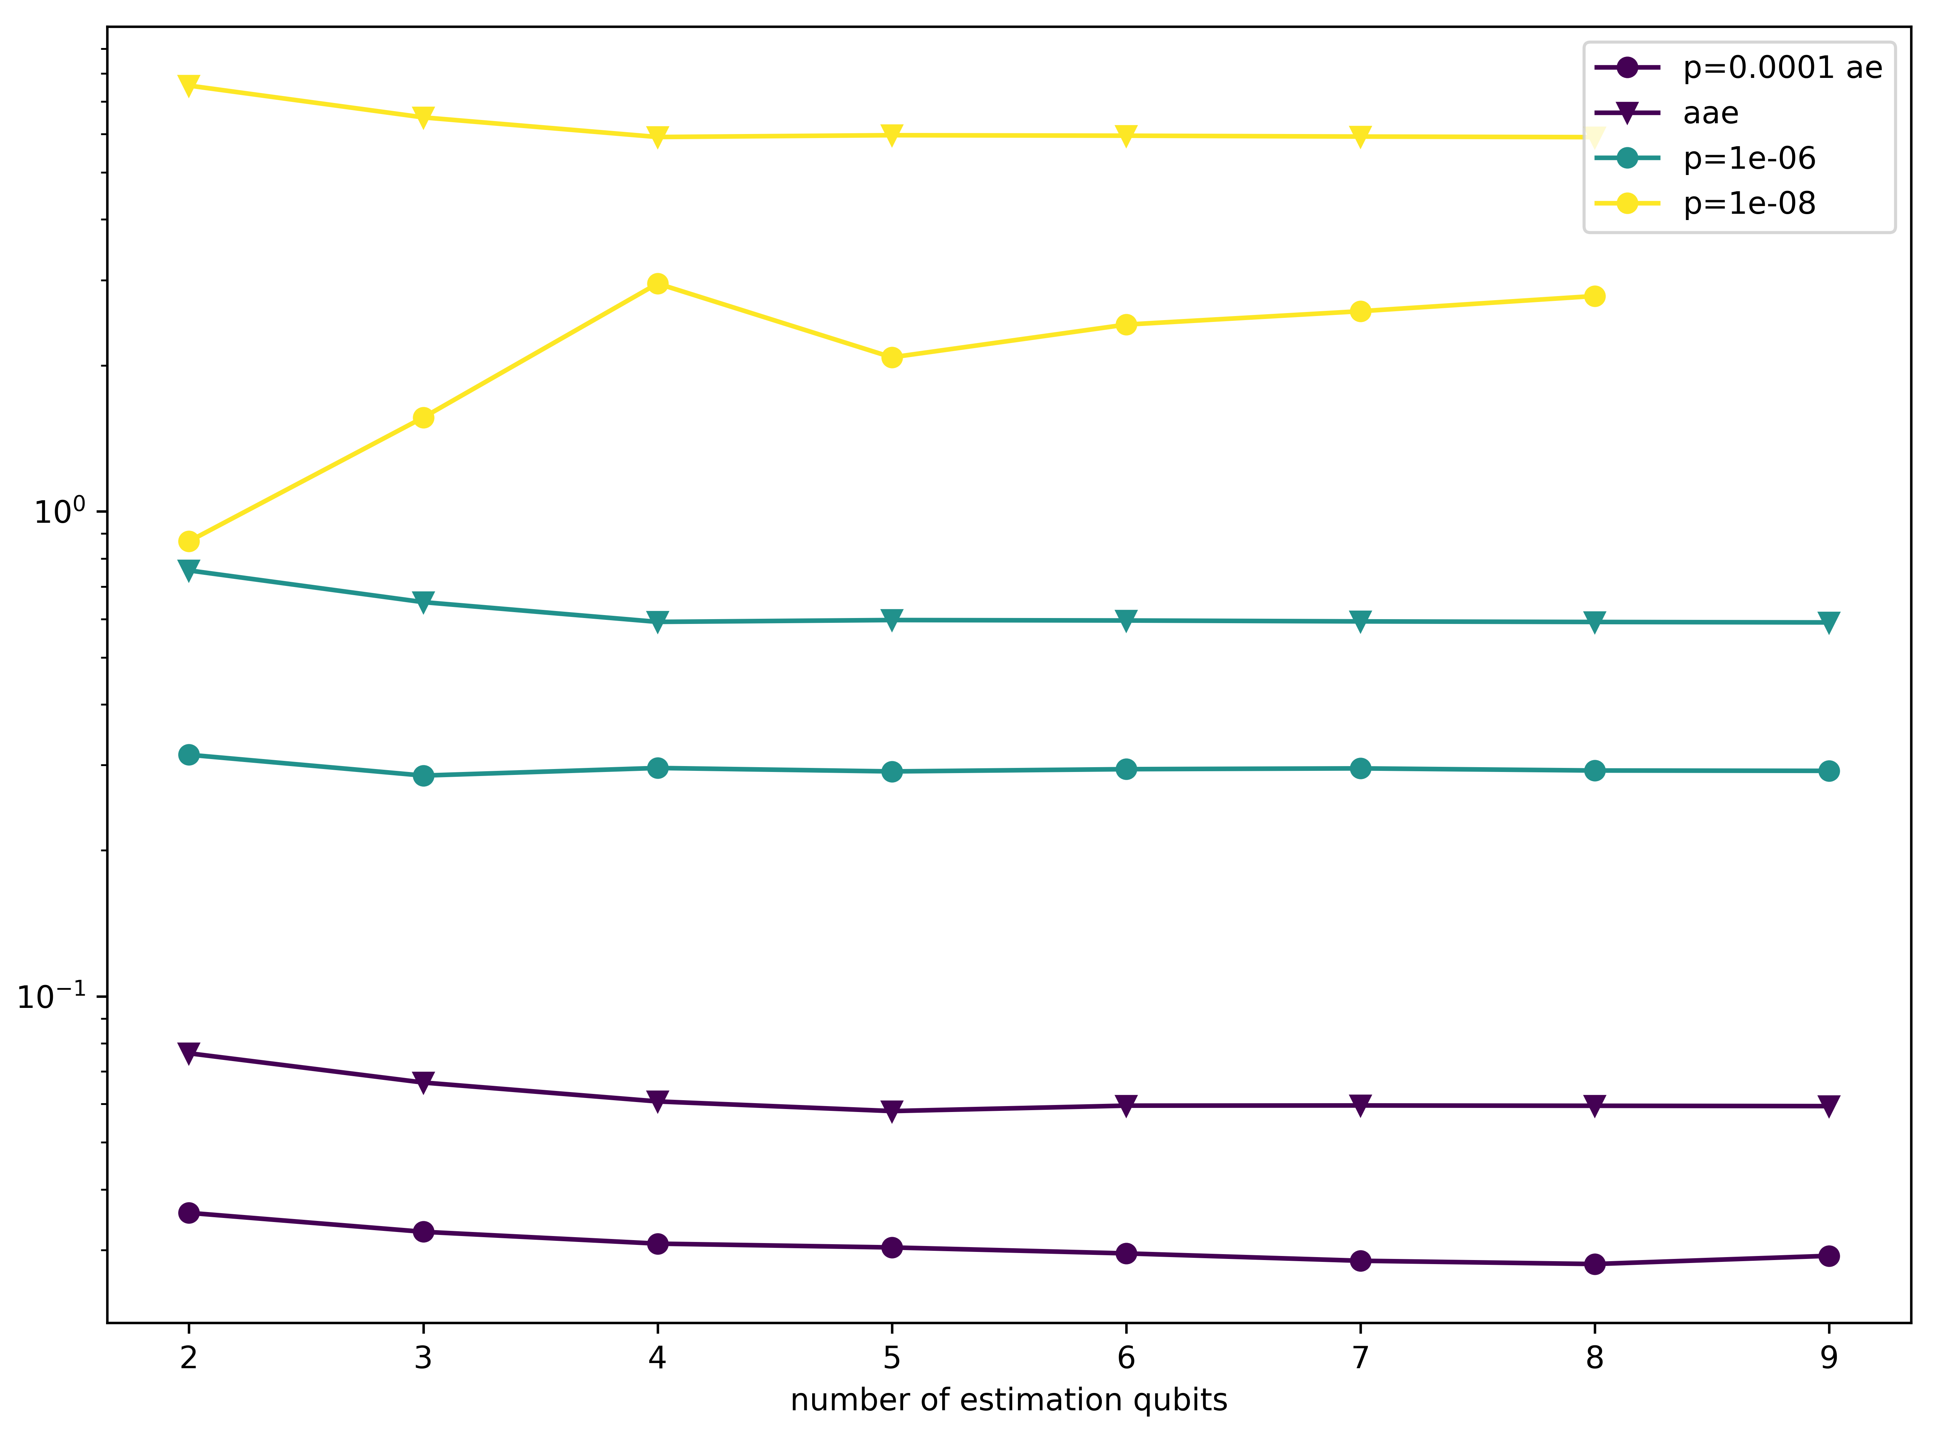
Implementation and convergence of
Amplified Amplitude Estimation: Exploiting Prior Knowledge to Improve Estimates of Expectation Values, S. Simon et al. 2024
x3
x3
x3
faster convergence rates
improved performance measure

Slide 14
Conclusion and perspectives
Results
Monte Carlo proposal on quantum computers
With quantum walks
Local probabilities of interactions
Reflective boundary conditions
« Absorbing » approximation
Failure of analog quantum walk
Classical importance sampling applied to quantum walks
Cannot follow weights of individual particles
Renormalization proposal
Tradoff between quantum & classical
Failure of analog amplitude estimation
X3 speedup with a priori estimate of the response (implementation of paper)
Perspectives
Adaptive Multilevel Splitting on quantum computers
Coming soon
Merge variance reduction techniques with amplitude amplification
Extract hitting probabilities
Preprint soon
Monte Carlo particle transport on quantum computers,
Noé Olivier and Michel Nowak, 2024

Slide 15
The team
Elise Fressart
Noé Olivier
PhD student
Quantum Computing researcher
elise.fressart@thalesgroup.com
noe.olivier@thalesgroup.com
Nicole Spillane
Michel Nowak
Applied Mathematics Researcher
Quantum Computing researcher
nicole.spillane@cmap.polytechnique.fr
michel.nowak@thalesgroup.com

